Slide 1
Applied Machine Learning Final Project: Home Credit Default Risk
Indiana University
December 2022
Group 11
Anuj Mahajan
Shubham Jambhale
Shashwati Diware
Siddhant Patil

Slide 2

Team Members:

Slide 3
Contents
Four P’s
Project Description
Summary EDA
Overview of modelling Pipelines
Results and discussion (Accuracy, AUC, Kaggle)
Conclusion and Next steps

Slide 4
Four P’s
Past:
We began the HCDR Project, which uses a variety of financial and nonfinancial variables to determine
whether borrowers will fail or not.
In the initial stage, we performed fundamental EDA and data collection.
We used these datasets to develop baseline models (Logistic Regression, Decision Tree, and Random Forest).
AUC and the Confusion Matrix were used to assess the accuracy.
Present:
We tunned the hyperparameters of the models, and found the best parameters using Grid Search.
In the steps above, we used the best parameters for each model, to evaluate the models.
We did extensive feature engineering to enhance the results.

Slide 5
Four P’s
Planned:
We will build Multi Linear Perceptron using PyTorch.
Use Tensorboard to visualize the results of training in real-time.
Problems:
With the given feature selection, we could not improve the test accuracy of Logistic Regression and Random Forest as compared to their baseline models.
Even if the Lasso and Ridge models AUC are on the upper side, accuracy is very low.

Slide 6
Project Description:
The object of the Home Credit Default Risk (HCDR) project is to predict the repayment abilities of the financially under-served population.
The well-established prediction is necessary for both Home Credit and borrowers.
Lend money to whom can pay back and give them a chance to build credit.
We use a variety of data, such as past credit information, credit type, past credit days left, payments, past
application information, etc.
We use categorical and numerical data to improve the accuracy of our predictions.
We provide appropriate datasets for machine learning models using EDA.
We trained and assessed a number of potential models before selecting the best one.
Our potential models include Random Forest, Decision Making Trees, Logistic Regression, Lasso Regression and Ridge Regression.
Accuracy, AUC, Confusion Matrix, and Log Loss are just a few of the measures we employ to evaluate
candidate models specifically.
We observed that Decision Tree (Hyper tuned) pipeline has the highest test accuracy which is then followed by the Logistic Regression (Hyper tuned), Random Forest(Hyper tuned), Lasso Regression (Hyper tuned) and Ridge Regression (Hyper tuned)

Slide 7
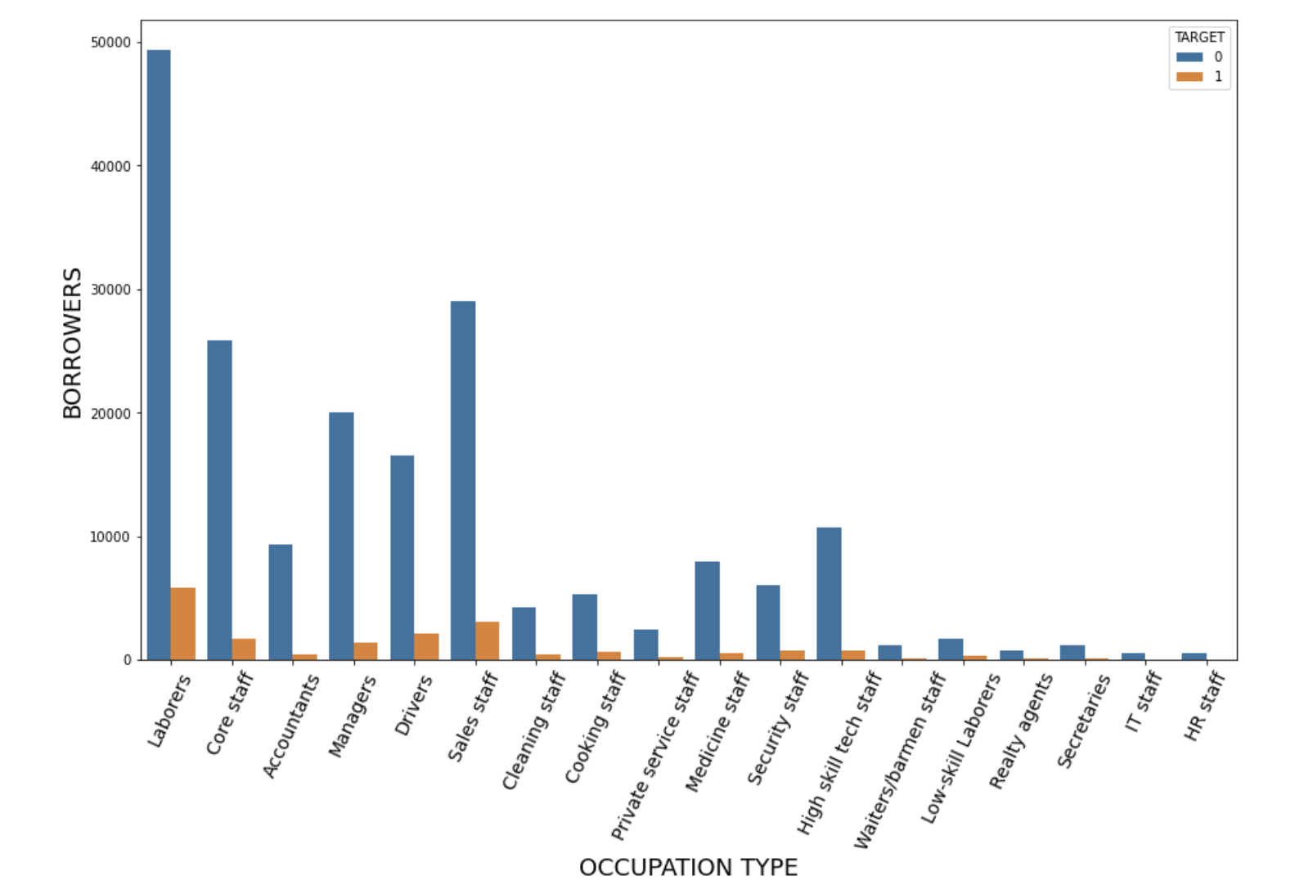
Exploratory Data Analysis (EDA):
We perform EDA and examine the following attributes of the data
Test Description, Dataset size, Summary Statistics, Correlation analysis, Checking missing values, etc.
Some Interesting EDA findings:
Occupation Type Vs Borrowers

Slide 8
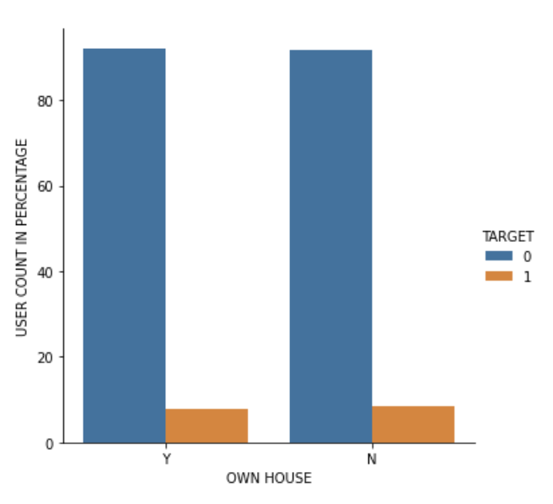
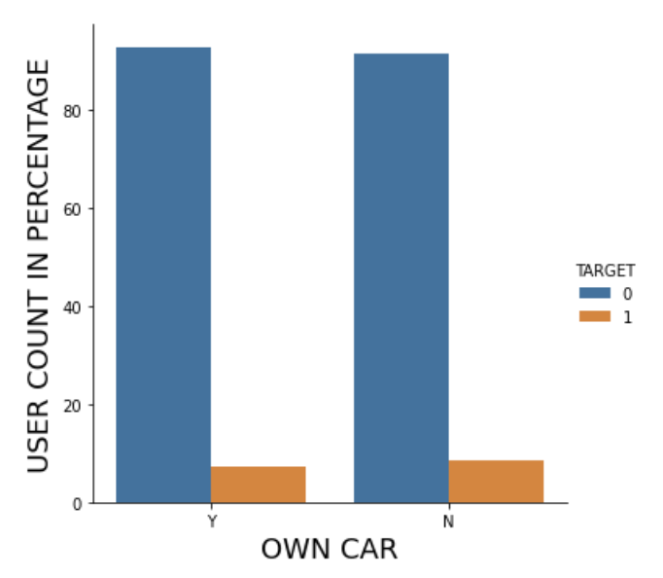
Exploratory Data Analysis (EDA):
Defaulters and Non-defaulter in terms of Home Ownership
Defaulters and Non-defaulter in terms of Car Ownership

Slide 9
Feature Engineering:
Feature selection and imputation
We discarded features with missing values of more than 30% and dropped irrelevant features.
We filled in the missing values of selected features.
Adding more relevant data
We decided to add relevant features based on our prior knowledge.
e.g. Annuity to Salary Ratio, AMT Credit to Annuity Ratio.

Slide 10
Modelling Pipeline:
The goal is to predict whether the borrower is a defaulter or not. Phase 3 involves creating hyper-parameter models (Logistic Regression, Decision Tree, Random Forest, Lasso Regression and Ridge Regression)
Separate the dataset into training and testing data
Prepare the input dataset by converting missing values and scaling the data.
Perform a hyper parameter tuning on the model.
Analyze the these model using measures for accuracy, AUC, and log loss.
Perform steps 1–4 for all the baseline models.

Slide 11
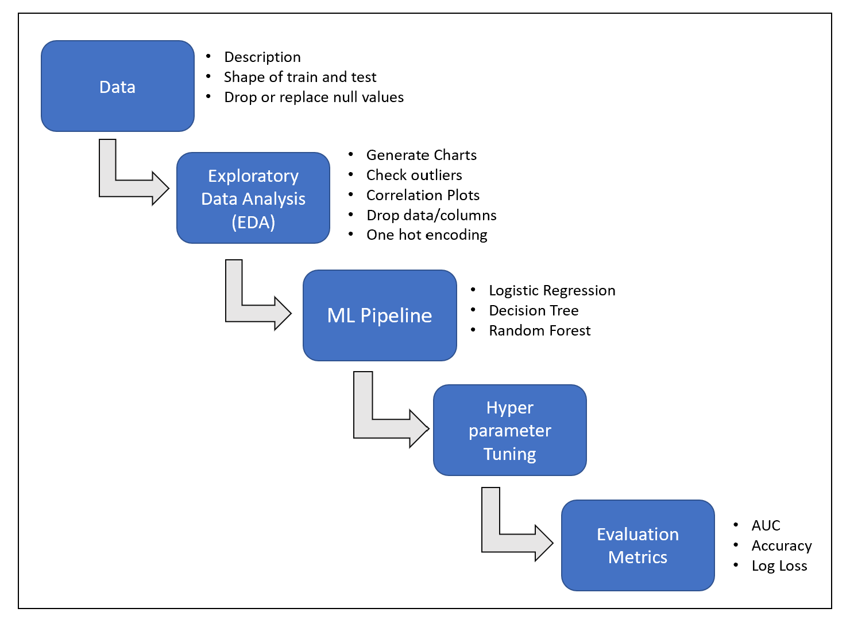
Modelling Pipeline Flow:

Slide 12
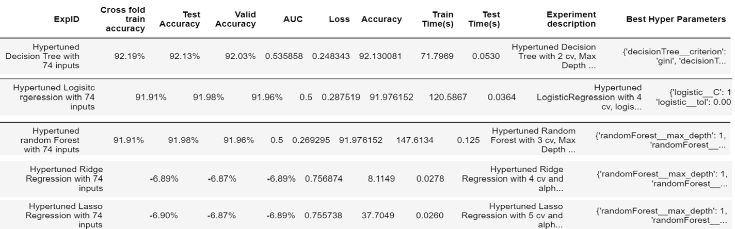
Result and Discussion:
Decision Tree performs well on the given dataset.
AUC and Accuracy (92.13) for Decision Tree are on the higher side.
Random Forest and Logistic Regression are on same page.
It provides the accuracy of 91.98.
Lasso and Ridge seems to have low test accuracy.
In turn AUC has increased significantly.
Below are the best experiment results for each model.

Slide 13
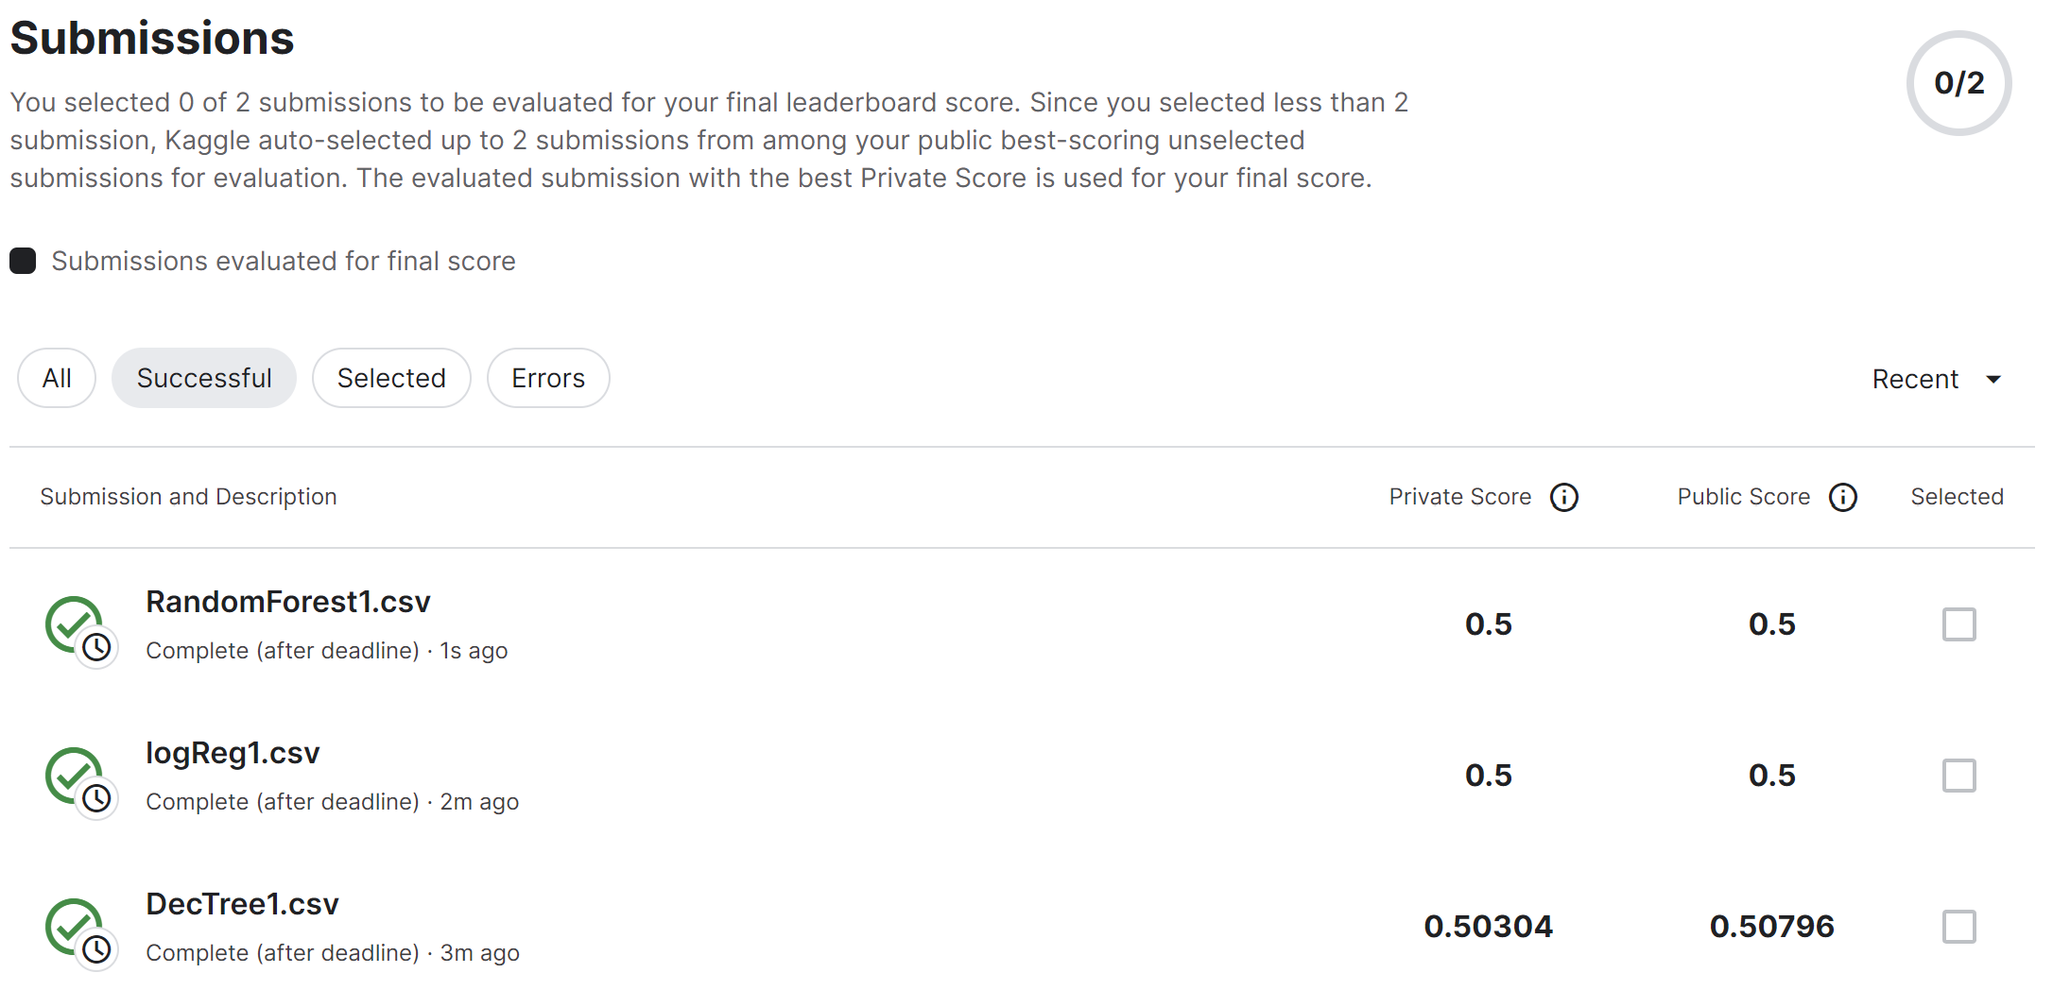
Result and Discussion:

Slide 14
Conclusion and Next steps:
In Phase 3 we conclude that the decision tree model performs the best out of all the other hyper tuned models.
Out of all the models, the random forest model and logistic regression have almost same performance.
Ridge and Lasso have very high AUC but the models suffered in accuracy.
In the future, we intend to put below:
MLP using PyTorch
Use Tensorboard to visualize the results.

